Slide 1
Smart Drip Chamber
EID 101
Anish Malladi
Arnold Wey
Gordon Macshane
Vishnu Kaimal
Yeonwoo Lee

Slide 2
The Problem
Notes:
Problem: Nurses spend 35% of the time on documentation and 20% on coordination.
Only 9% of the time is spend diagnosing patients.
Existing IV assemblies are time consuming to monitor, and manual recording and calculation of DPM leaves room for error in a stressed, over-worked nurse at the end of his or her shift. In addition, the patient may roll onto the IV tubing, or some other anomaly with the assembly may occur, resulting in improper dosage and possibly air embolism.

Slide 3



The Problem
Low Fluid Levels
Overworked Staff
Delivery precision
Replace text as required

Slide 4
The Solution
Use a Spark Core to connect drip chamber to Hospital records
Notes:
All of these problems can be alleviated by automating the recording of drip chamber readings, reporting them to the EHR, and sending alerts out to nurses on duty over WiFi if an anomaly occurs.

Slide 5
The End User vs the Buyer
Nurses?
Doctors
Hospitals?
VACs?
Distributors?

Slide 6
How do we take such a product to market?
Notes:
The Hospital personnel and Biomedical experts we solicited for help often contributed feedback on the device's functionality, but gave no clue as to how to make the Smart Chamber a reality in hospitals across not only the United States, but the entire world.
In order to approach Distributors and Manufacturers for Manufacturing or Licensing agreements, we first need to secure a patent for our product. From here it’s just simply finding any one of Medical Action Industries, Medline, or Braun and negotiate an agreement.

Slide 7
Dr. Jessica Robinson-Papp, MD
– Doctor at Beth Israel
Notes:
HOWEVER, she wasn’t sure who purchased Medical supplies at Mt. Sinai
Tel: 212-241-8390

Slide 8
Dr. Chaitan Devulapalli
– Doctor at Washington Brain and Spine Institute

Slide 9
Kenneth A. Pascale
- Ideas on policy compliance and IV manufacturers

Slide 10
Ryan Oeullet
– System Supply chain for hospitals
Notes:
1. Channel the product of evaluation through Value Analysis Consultant
And this opened our eyes to the grand bureaucracy

Slide 11
The Value Analysis Committee
– The people who decide whether a product is worth it or not
Notes:
http://www.mddionline.com/article/strategies-medical-device-manufacturers-address-hospital-value-analysis
In the past, physician preference primarily drove device usage.

Slide 12
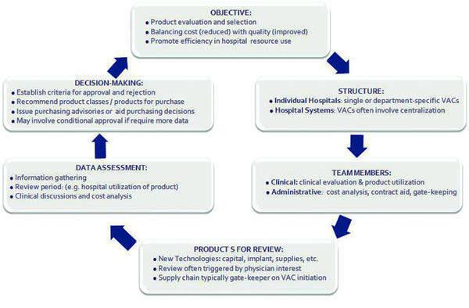
VAC Decision Flow

Slide 13
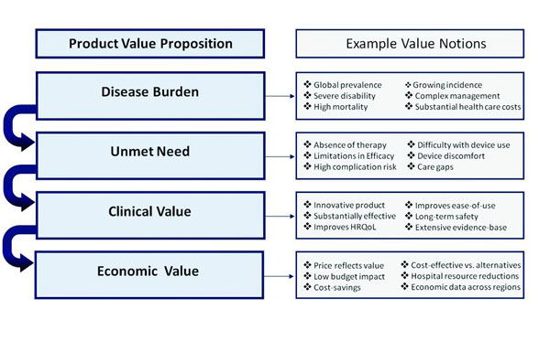
Value Proposition

Slide 14
Steve Everly
– Trade Show Coordinator

Slide 15
Medline
Awaiting Response

Slide 16





Slide 17
Kickstarter
Created a faux Kickstarter page
Creating a video to upload to page
Rewards to backers decided

